Slide 1
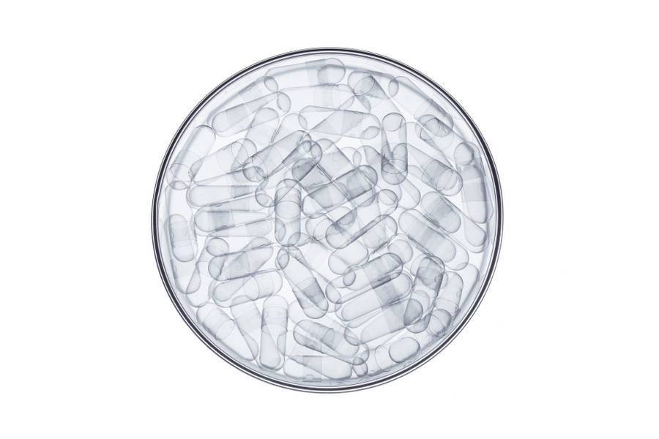
Substantiating Diagnostic Capabilities with Generative ADVERSARIAL Networks using Chest X-Ray images
Abhishek srivastava

Slide 2

Agenda
Motivation
Approach
Dataset
RESULTS
challenges

Slide 3
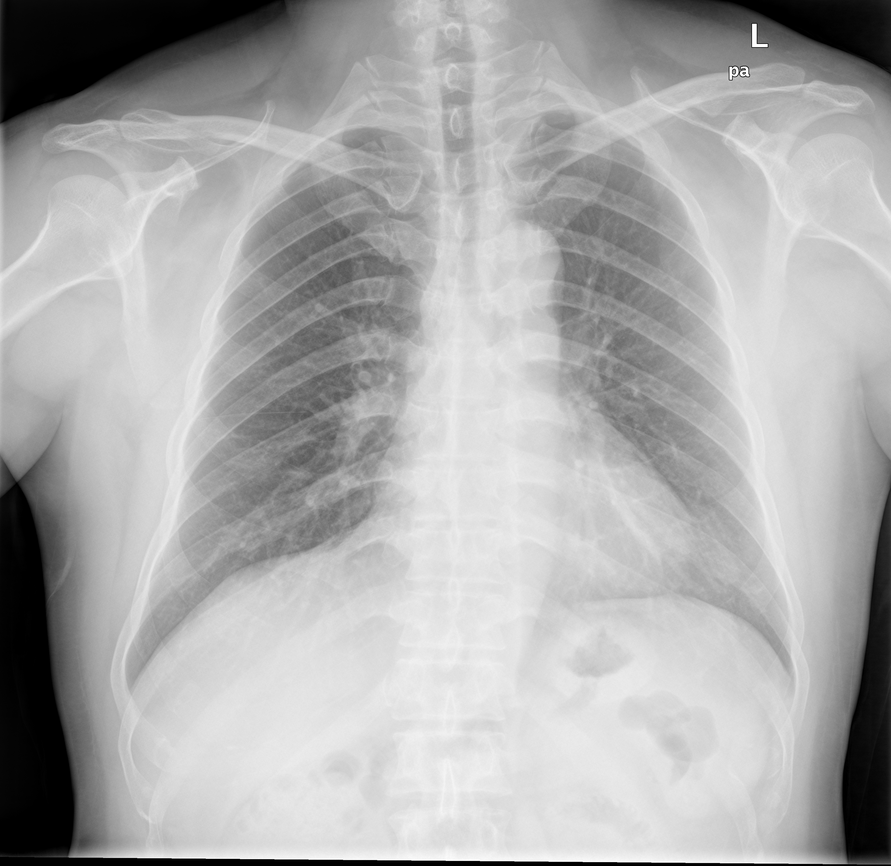
Nearly 3 million tuberculosis cases remain undiagnosed each year
Problem Early and accurate diagnosis of Tuberculosis Solution Automated and real-time prediction of Tuberculosis with certain confidence Why GAN?
Limited unsupervised disease detection models available It is more difficult to find examples of tuberculosis patients than healthy patients Can be extended for diagnosis of other pulmonary diseases

Slide 4
Agenda
Motivation
Dataset
Approach
RESULTS
challenges

Slide 5
Training and testing on multiple data sources adds generalizability
China Set - The Shenzhen set
Montgomery County - Chest X ray
TBX11K (512 X 512)
336 cases with manifestation of tuberculosis
326 normal cases
Resolution 3K X 3K
58 cases with manifestation of tuberculosis
80 normal cases
Resolution: 4020 X 4892 or 4892 X 4020
1,200 cases with manifestation of tuberculosis
5,000 healthy cases
5,000 sick & Non-Tb patients
Find Shenzhen set Description from Openi library
Find Montgomery county set Description from Openi library
Find TBX11K Description from Kaggle

Slide 6
Agenda
Motivation
dataset
Approach
RESULTS
challenges

Slide 7
Generate Healthy image PatterNS using GAN
Pre-process chest X-ray images
AnoGAN Architecture for Anomaly Detection
Train AnoGAN on Healthy ‘original’ images
Identify appropriate threshold of anomaly score
A Streamlit app predict Tuberculosis provided an X-Ray images
Data Pre-processing
Model training
Optimization and App development
Z (Random Noise)
G
D
Z (Random Noise)
G
D
Test data
Train data
L_{R}
Is D correct?
L_{d}
Real Image
Real Image
Model Training
Real Image
Anomaly Detector

Slide 8
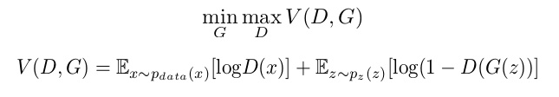
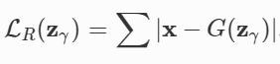
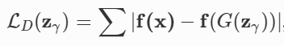
Choose threshold to detect anomalous images
The GAN model attempts to generate real-like (non-anomalous or healthy) images, while generator and discriminant follows two-player minmax game with value function V(G,D)
When GAN is supplied with a test anomalous image, total anomaly score is calculated which is a weighted sum of Residual Loss, L_{R} (λ) and Discriminant loss, L_{D} (1 - λ)
The distribution of anomaly scores from a well trained model should lie at a separable distance for healthy and un-healthy patients

Slide 9
TbX11K and Shenzhen healthy X-Rays was USED to TRAIN ANOGAN
Training Data
Patients | TBX11K | Shenzhen | Montgomery County
Sick or Tb | 0 | 0 | 0
Healthy | 3,377 | 251 | 0
Validation Data (To decide threshold)
Tb | 101 | 201 | 0
Testing Data
Healthy | 348 | 75 | 80
Tb | 699 | 135 | 50
Sick and Non-Tb | 3,800 | 0 | 0
Note
Montgomery was not used while training the GAN, to evaluate performance of GAN with unseen chest X-Rays images from different sources.
*Tb stands for Tuberculosis

Slide 10
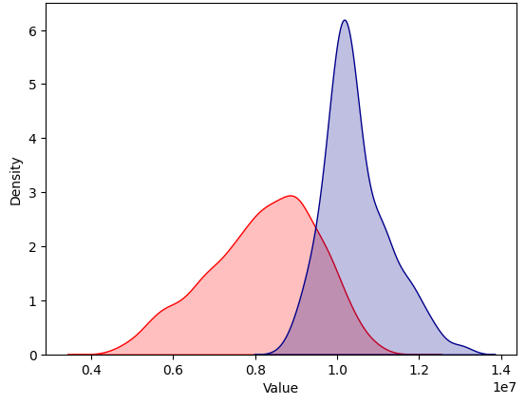
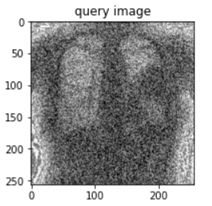
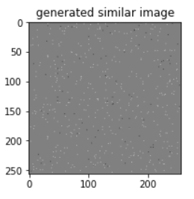
Anomaly Scores were observed on Validation set to choose threshold
Anomaly score of 9.5 x 10⁶ was chosen as the threshold to best classify healthy and Tuberculosis patients
While training GAN, the attempt is to train generator to reconstruct similar discernible healthy images however, in case of limited computational power, GAN may learn to reconstruct healthy pattern just enough enabling detection of desired diagnosis
Healthy (Red) and Tb (Blue) anomaly scores on validation set after hyper parameter tuning

Slide 11
Parameters were tuned for best separated healthy and TB patients
Hyper-parameters | Explored | Used
Length of Noise vector (Z) | [10, 20, 50] | 10
Image dimensions | 28X28; 64X64; 256X256 | 256X256
Proportion of discriminator and residual loss | λ = [0.5, 0.9, 1] | 0.9
Optimizer | Adams, RMSprop | RMSprop
Learning rate | For discriminator = [0.0001, 0.004] For generator = [0.0001, 0.002] | For discriminator = 0.0004 For generator = 0.0002

Slide 12
Agenda
Motivation
dataset
Approach
RESULTS
challenges

Slide 13
Model performed best with Shenzhen and worst with MontGomery Data
Model Performance on Test data
Datasets | Accuracy | F1-Score
TBX11K | 71.5% | 65.8%
Shenzhen | 84.7% | 85.7%
Montgomery | 55.1% | 41.2%
Highest recall of 94.1% was observed on Shenzhen dataset, it only included pulmonary Tb patients
Lowest model accuracy and F1-score on Montgomery dataset concludes that the GAN trained is subject to source of Chest X-Ray images
On sick and Non-Tb, an accuracy of marginally more than 50%, which could be because such sick patients may not have a pulmonary disease

Slide 14
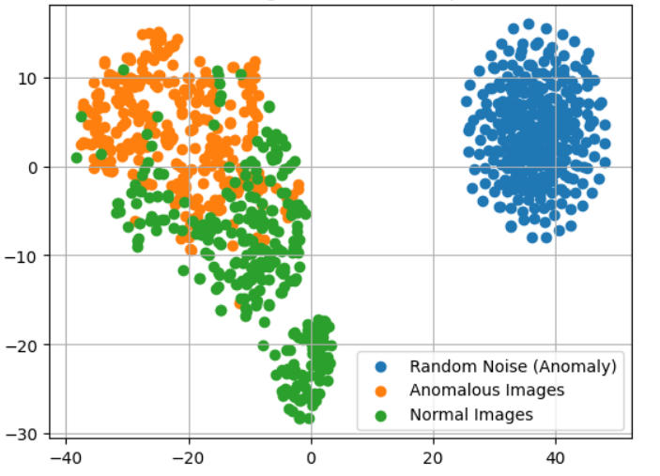
GAN learnt sensible anatomical features
Almost well separated normal and anomalous images showcased that the discriminator was able to learn features while training that separates healthy and sick patients
Embedding of random noise was clearly far away from normal and anomalous images, highlighting that the model can not be fooled when supplied with normal noise
t-SNE embedding of normal (green) and anomalous (orange) images on the feature representation of the last convolution layer of the discriminator.

Slide 15
Agenda
Motivation
dataset
Approach
results
challenges

Slide 16
GANs ARE COMPUTAIONALLY EXPENSIVE
Current AnoGAN architecture takes > 2 hour to train on 3,800 images of shape 256X256 from TBX11k and Shenzhen data
Find detailed architecture and code on my GitHUB
Model deployment using Streamlit takes 3-4 minutes for a single prediction
The current architecture deployment would not recommend predicting tuberculosis for test image with size less than 256 X 256
GANs performance for this use case was strongly found subject to source of chest X-Ray images, resulting in poor performance on Montgomery dataset

Slide 17
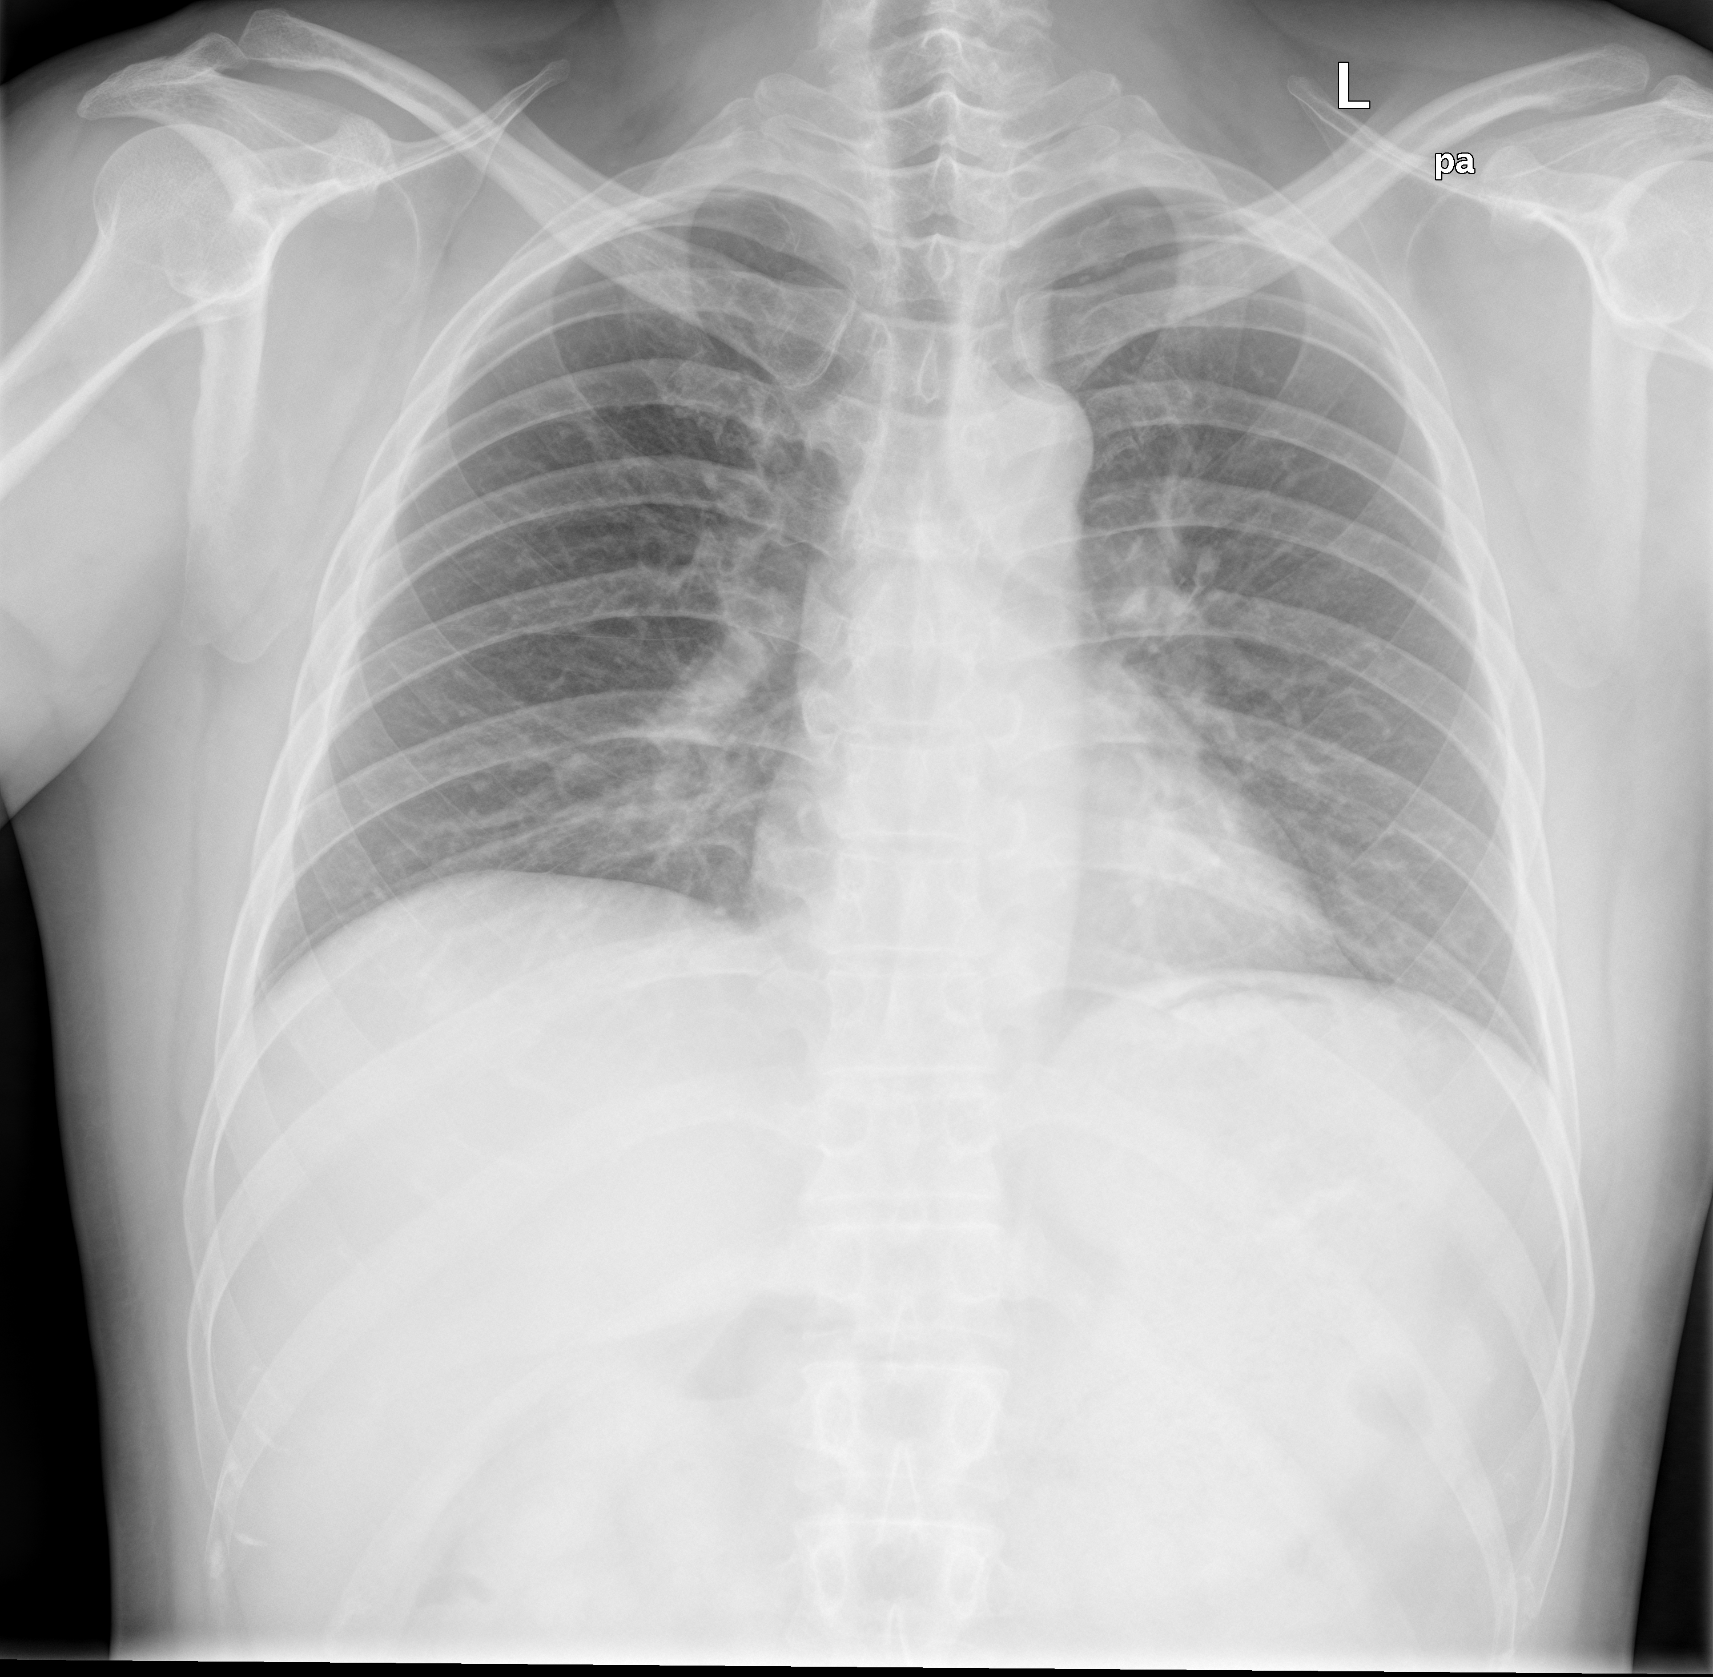
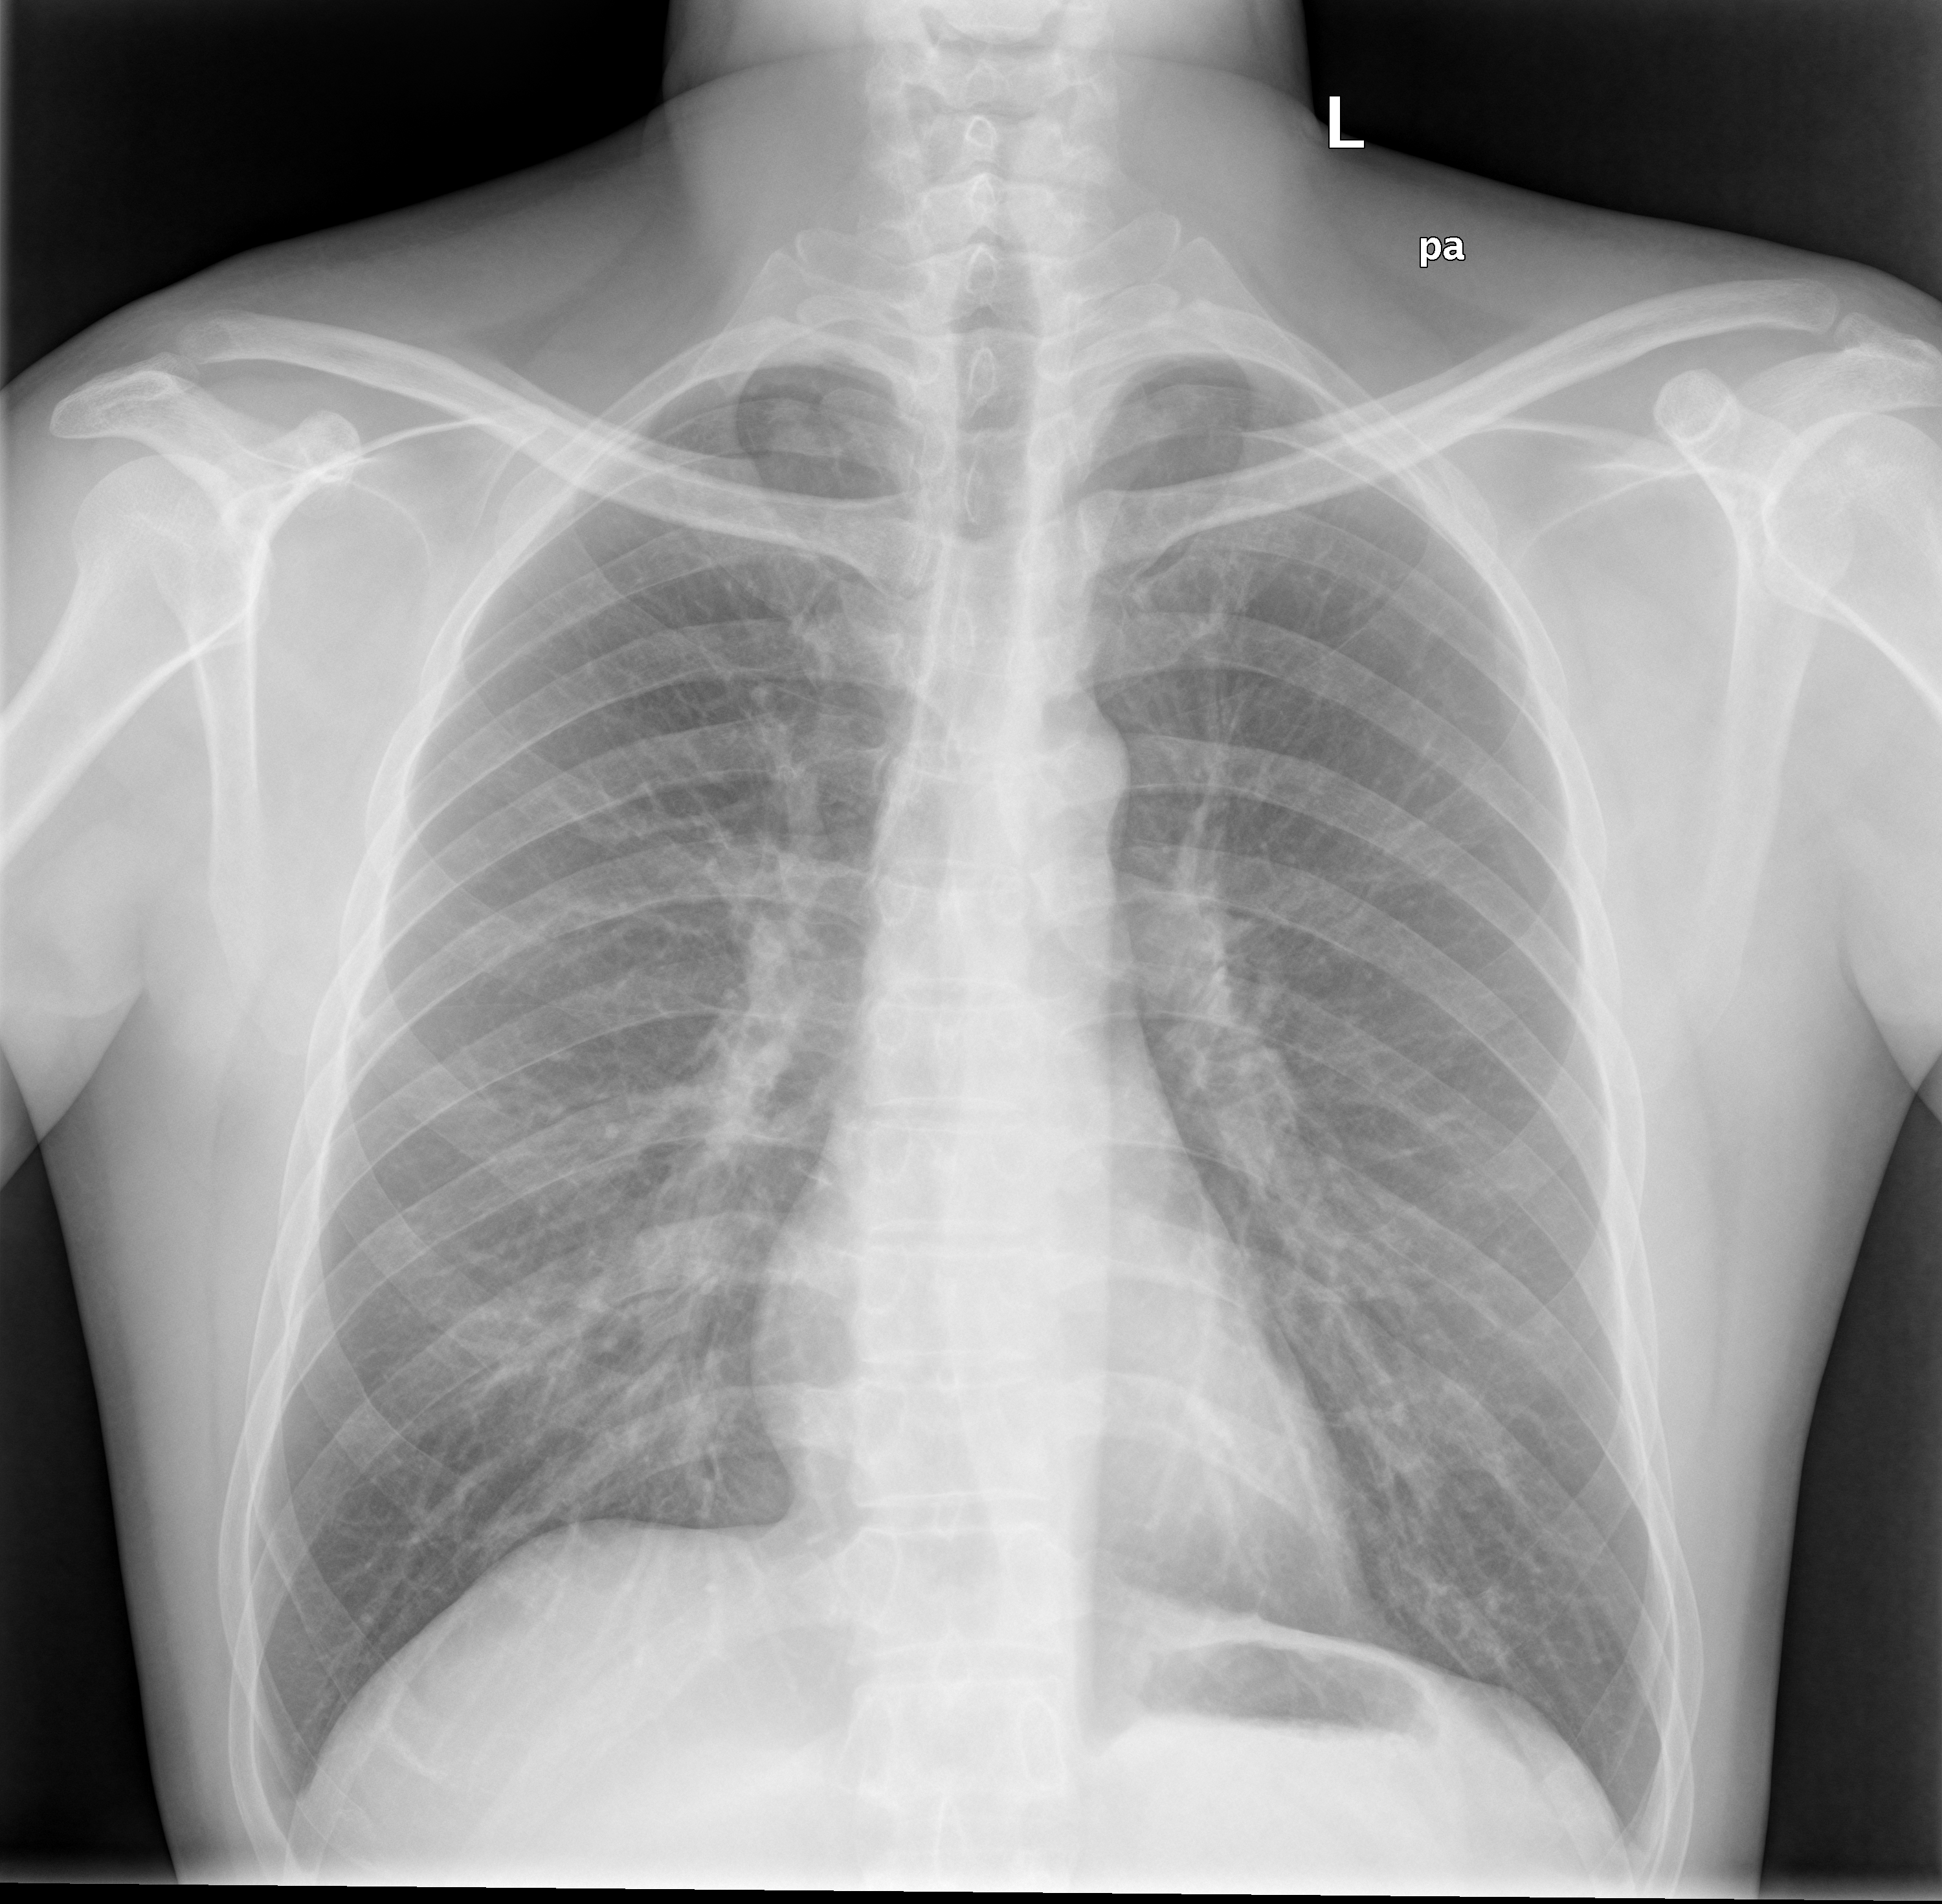
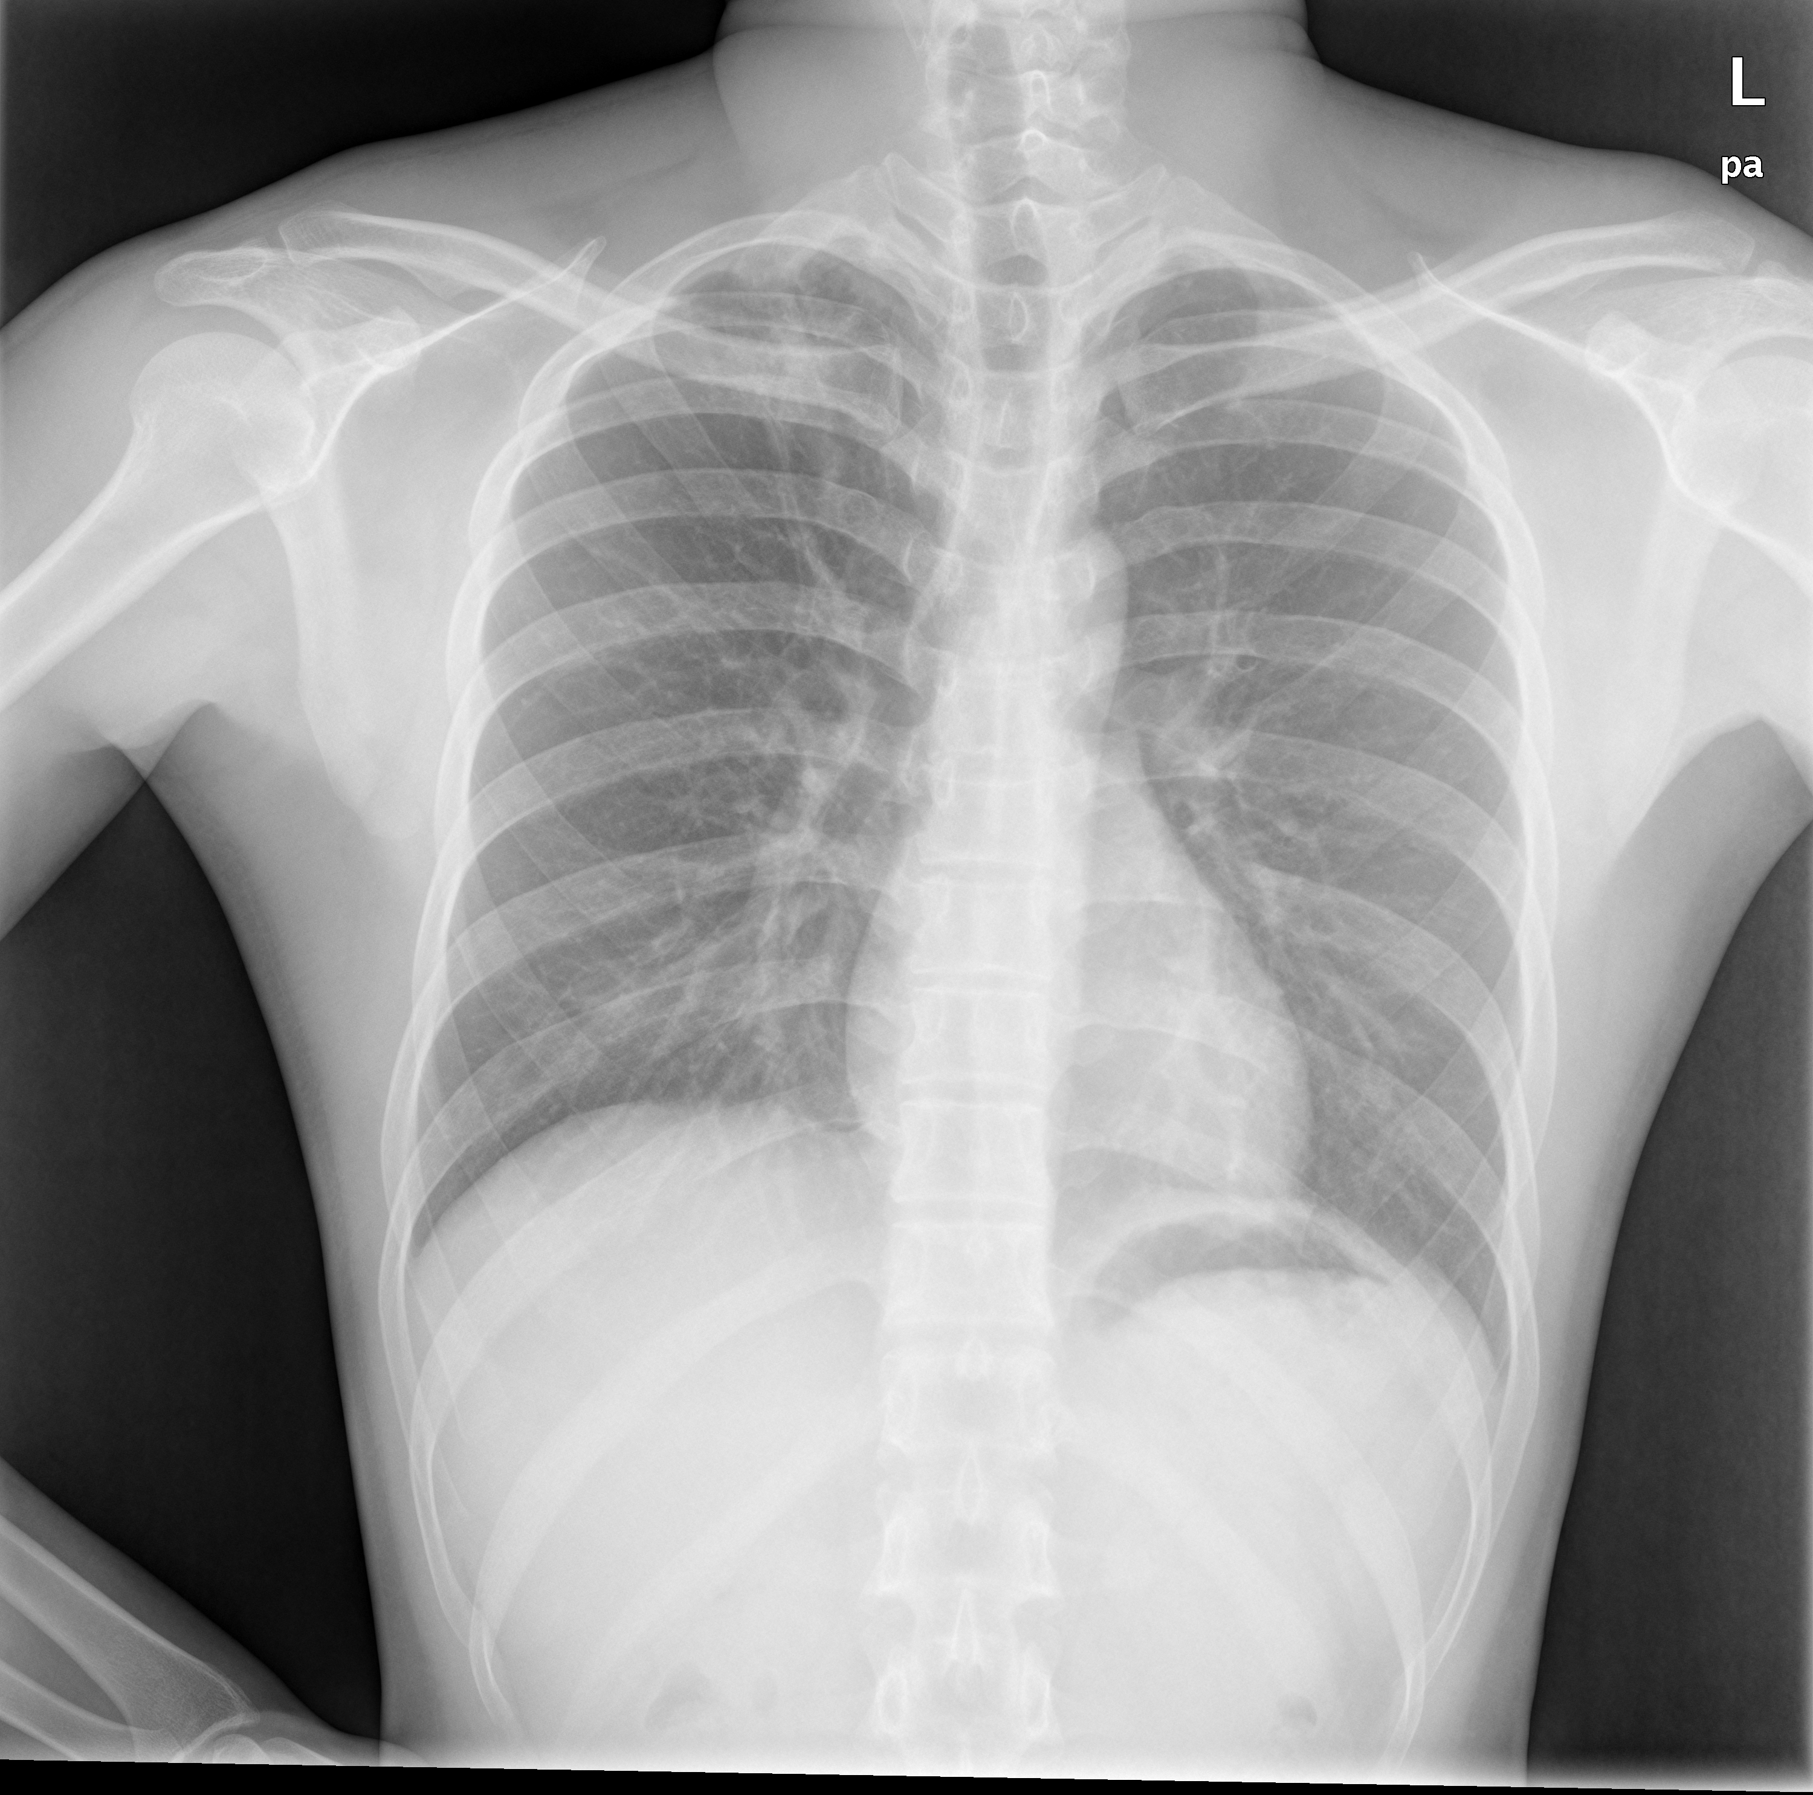
Questions?
Which one has Tuberculosis, Can you tell?
Let’s see if the “Tuberculosis prediction App” can find out!

Slide 18
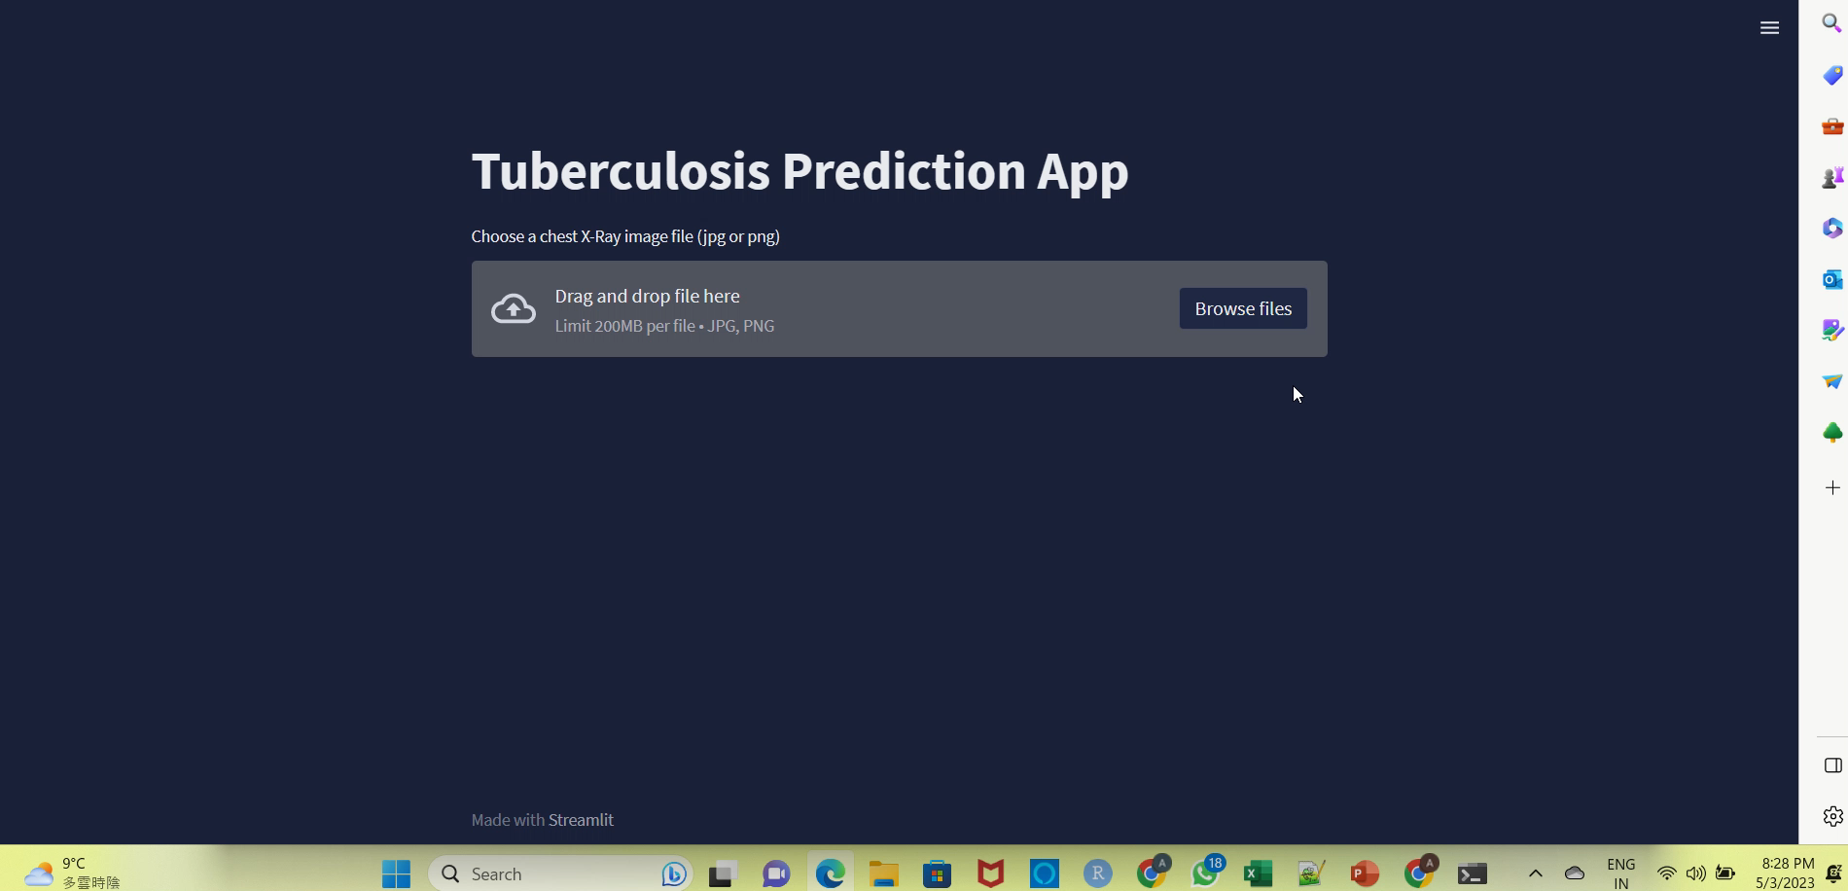
Streamlit APP DEMO

Slide 19


Thank you
Abhishek Srivastava​

